Slide 1
Week 6
Sustainability & Innovation

Slide 2
Session Outline
Identifying Green Consumers
Building a Sustainable Brand
Developing Green Markets
Product Design and Innovation
Summary
Vocabulary Review
Required Materials
Supplementary Materials
Assignment

Slide 3
Learning Objectives
Identify characteristics of green consumers
Identify strategies for building a sustainable brand
Describe trends in developing green markets
Give examples of innovative product design and business models

Slide 4
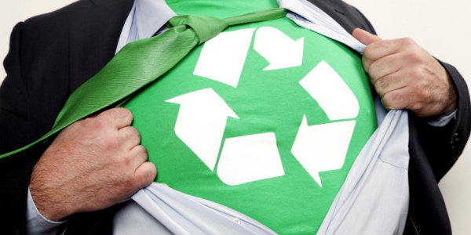
Identifying Green Consumers
What is a green consumer?
What accounts for the rise of green consumers?
[Printing Hub. [Image]. Retrieved from: http://www.printinghub.org/wp-content/uploads/2014/01/goinggreen.jpg]

Slide 5
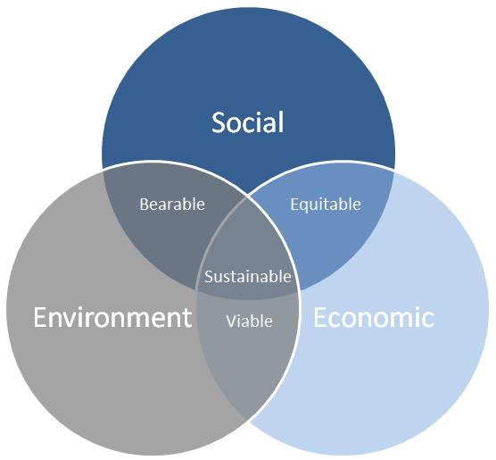
Green Consumer
They are sincere in their intentions, with a growing commitment to greener lifestyles (reducing carbon footprint)
almost always judge their environmental practices as inadequate (continuous improvement)
look for companies that are taking substantive steps and have made a commitment to improve (IISD, 2013).
[Titan America. [Image]. Retrieved from: http://www.titanamerica.com/uploads/3%20pillars%20of%20sustainability.jpg]
Notes:
Image Source:

Slide 6
Green Trends
Information availability and transparency
Increase labels and communication
Observation of environmental crises worldwide
Ex. Climate Change
Presence of green options in the marketplace
Creating demand for Non-GMO, Organic, Locally produced, etc.

Slide 7
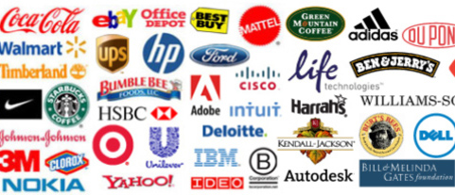
Building a Sustainable Brand
What is a brand?
“A name, term, design, symbol, or any other feature that identifies one seller's good or service as distinct from those of other sellers (AMA, 2016)”
[Sustainable Brands. [Image]. Retrieved from: http://www.sustainablebrands.com/sites/default/files/about_slides/aboutslide-481x207-TODAY.jpg]
Notes:
Image Source:

Slide 8
Elements of a successful brand
Positioning: Be different, be focused, be relevant
Brand Promise: Convey a compelling benefit, be authentic, and live up to it
The Tagline/Slogan: Make it short, simple, believable, memorable
Personality: Solicit testimonials, maintain a blog, avoid jargon, be real (e.g. use employees in ads)

Slide 9
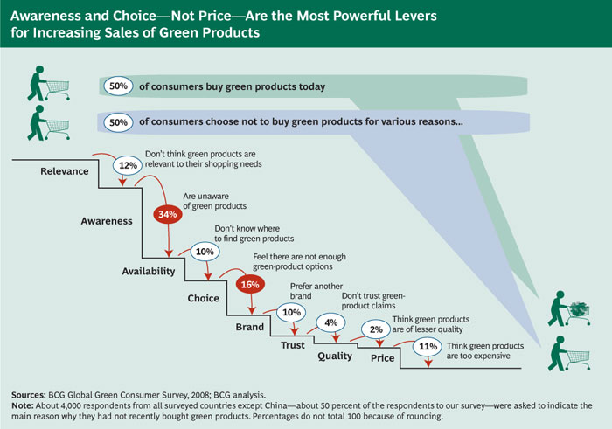
Sustainability Trends
-Surveyed Consumers 18-65 years old
-From Canada, France, Germany, Italy, Japan, Spain, UK, USA
[Sloan Review. [Image]. Retrieved from: http://sloanreview.mit.edu/files/2009/02/capturing-green-ex7-7004.jpg]
Notes:
Image Source:

Slide 10
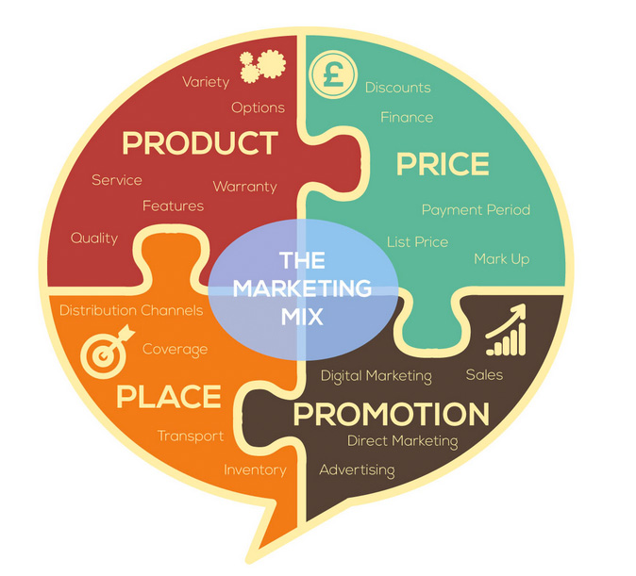
Developing Green Markets
How to market?
Marketing Mix
Product
Price
Place
Promotion
3 Spheres Sustainability
[Relative Marketing. [Image]. Retrieved from: http://www.relativemarketing.co.uk/understanding-the-marketing-mix-and-the-4-ps/]
Notes:
Image Source:

Slide 11
Greenwashing
When a company or organization spends more time and money claiming to be “green” through advertising and marketing than actually implementing business practices that minimize environmental impact (Greenwashingindex.com, 2016).
Examples
Hotel’s reusing sheets, but not focusing on the entire operation
Bank’s going paperless, but not investing in green companies
Energy companies investing little in renewable energy, while having an oil spill or polluting the air

Slide 12
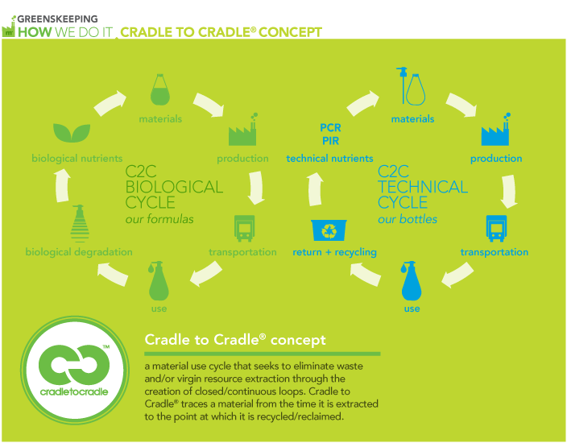
Product Design and Innovation
Innovation: a new method, idea, product, etc.
Meet consumers needs
Green product envisioning
Closed-loop systems
[ACDI. [Image]. Retrieved from: http://acdi.uct.ac.za/blog/cradle-cradle-possibility]
Notes:
Image Source:

Slide 13
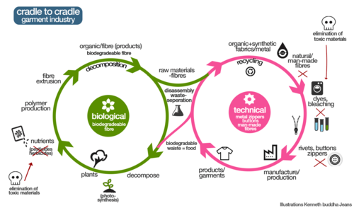
Cradle to Cradle
[Tumbler. [Image]. Retrieved from: http://66.media.tumblr.com/cc130d791a6485a875705ad73d924a08/tumblr_inline_nilj6gVlf31qzdvrx.png]
Notes:
Image Source:

Slide 14
Sharing Economy
Peer-to-peer business model
*Some argue “Access Economy”
Connection to Information Technology
Types
Product-Service Systems
Redistribution Markets
Collaborative Lifestyles
Crowdfunding platforms

Slide 15




Product Service Systems
Rideshare: Use personal vehicle like a taxi service
Vacation Rentals: Use personal house or property like a hotel rental
[Rideshareapps. [Image]. Retrieved from: http://rideshareapps.com/wp-content/uploads/2015/07/uber-and-lyft-side-by-side.png]
[airbnd.com. [Image]. Retrieved from: https://a2.muscache.com/airbnb/static/logos/belo-1200x630-a0d52af6aba9463c82017da13912f19f.png]
:
[Flipkey.com. [Image]. Retrieved from: https://static.tripping.com/uploads/image/0/312/flipkey.png]
:
[tripping.com. [Image]. Retrieved from: static.tripping.com/uploads/image/0/321/Tripping-Logo.png]
:
Notes:
Image Source:

Slide 16





Redistribution Markets
Auction website
Online Classifieds
Clothing Consignment
Electronics Marketplace
[backpage.com. [Image]. Retrieved from: https://knoji.com/images/logo/backpage.png]
[ebay.com. [Image]. Retrieved from: https://upload.wikimedia.org/wikipedia/commons/thumb/1/1b/EBay_logo.svg/2000px-EBay_logo.svg.png]
:
[craigslist.org. [Image]. Retrieved from: www.brandeps.com/logo-download/C/Craigslist-01.png]
[usell.com. [Image]. Retrieved from: https://upload.wikimedia.org/wikipedia/en/9/90/Usell_logo.png]
[swap.com. [Image]. Retrieved from: media.marketwire.com/attachments/201503/311339_swap.com-logo_300x80.jpg]
Notes:
Image Source: Ebay.com
Image Source: Craigslist.com
Image Source: usell.com
Image Source: Swap.com

Slide 17


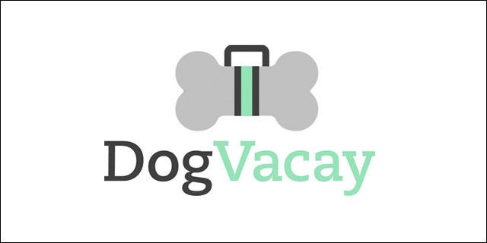
Collaborative Lifestyle
Digital Services
Household errands/skilled task
[taskrabbit.com. [Image]. Retrieved from: https://blogdottaskrabbitdotcom.files.wordpress.com/2014/04/taskrabbit-logo-for-marlin-2.png]
Pet sitting service
[dogvacay.com. [Image]. Retrieved from: https://upload.wikimedia.org/wikipedia/en/e/e4/Dogvacay_Logo.jpg]
[fiverr.com. [Image]. Retrieved from: https://p6.zdassets.com/hc/theme_assets/38806/1752/fiverr-logo-new.png]
Notes:
Image Source: Taskrabbit.com
Image Source: fiverr.com
Image Source: Dogvacay.com

Slide 18

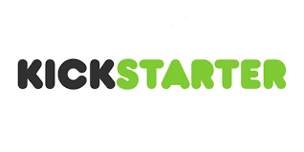

Crowdfunding
Project/Entrepreneur fundraising
Do-it-yourself fundraising
Microfunds/Microloans
[gofundme.com. [Image]. Retrieved from: 96d6c647b06658b1ab88-3dd041e57df6d4ab2a46b2d05c7ff54a.r38.cf1.rackcdn.com/homepageshare.jpg]
[kickstarter.com. [Image]. Retrieved from: https://www.kickstarter.com/download/kickstarter-logo-light.png]
[kiva.com. [Image]. Retrieved from: www.hannahgrimes.com/wp-content/uploads/Kiva-logo.png]
Notes:
Image Source: gofundme.com
Image Source: Kickstarter.com
Image Source: kiva.com

Slide 19
Summary
Learning Objectives
Identify Green Customers
Understand Sustainable Brand
Developing Green Markets
Product Design and Innovation

Slide 20
Vocabulary Review
Please note that several of these terms were introduced in Week 3. As you can see, these terms can be defined in multiple ways.
Closed-loop system: also known as a feedback control system is a control system which uses the concept of an open loop system as its forward path but has one or more feedback loops or paths between its output and its input.
Cradle to cradle: biomimetic approach to the design of products and systems. It models human industry on nature's processes viewing materials as nutrients circulating in healthy, safe metabolisms (closed loop system).
Cradle to grave: extending throughout one's life, from birth to death or extraction to disposal
Life cycle assessment: is a technique to assess environmental impacts associated with all the stages of a product's life from cradle to grave (i.e., from raw material extraction through materials processing, manufacture, distribution, use, repair and maintenance, and disposal or recycling)
GRI: an international independent standards organization that helps businesses, governments and other organizations understand and communicate their impacts on issues such as climate change, human rights and corruption
Green Indexes: complete family of environmental indexes, tracking the growing sustainability sector
Innovation: a new method, idea, product, etc.
Marketing Mix: Price, product, place, and promotion
Sharing Economy: is a socio-economic ecosystem built around the sharing of human and physical resources. It includes the shared creation, production, distribution, trade and consumption of goods and services by different people and organizations.

Slide 21
Required Materials
Video
Green Markets: Innovating for Sustainability, Dr. Michael Russo. Available on the course website.
The Business Logic of Sustainability, Ray Anderson, TED, Feb 2009.
Reading
Knowing Cradle to Cradle Manufacturing and the Best Products for a Safe and Eco-conscious Home, EcoFriend.Org, 8 Jul 2016.

Slide 22
Supplementary Materials
Video
Cradle to Cradle Design, William McDonough, TED, Feb 2005.
Websites
The Sustainability Consortium
BSR
Center for Climate and Energy Solutions
Ceres
Green Indexes
NASDAQ® Clean Edge® Green Energy Index (CELS)
NASDAQ® Green Equity Indexes
Sustainable Business 20 (SB20)
Dow Jones Sustainability Index Family
S&P ESG Index Family
S&P ESG Sovereign Bond Index Family

Slide 23
Assignment
Interview 5 people, asking the following questions about their green consumer attitudes and documenting their responses.
On a scale of 1 to 5 (1-Strongly Disagree, 2- Disagree, 3 – Neutral, 4-Agree, and 5-Strongly Agree), how much do the following categories influence your behavior to help the environment?
Financial incentive/reward
Financial Penalty
See people I know taking action
People I know encourage me to take action
I hear someone talking about the dangers of not taking action
I hear someone promoting the benefits of taking action
I see news media coverage encouraging me to take action
Government officials encourage me to take action
A non-profit organization encourages me to take action
I see advertisements or public notices encouraging me to take action
A celebrity I respect encourages me to take action.
Document the results for each person interviewed and write a short (one paragraph up to half page) summary on your findings.

Slide 24
References
2010 BCG Global Report on Consumer Sentiment: A New World Order of Consumption. (2016). Retrieved August 9, 2016, from http://www.bcg.com/documents/file51606.pdf
American Marketing Association. (2016). Retrieved August 9, 2016, from https://ama.org/
Anderson, R. (2009, February). Ray Anderson: The Business logic of sustainability [Video file]. Retrieved from http://www.ted.com/talks/ray_anderson_on_the_business_logic_of_sustainability
BSR. (2016). Retrieved August 09, 2016, from http://www.bsr.org/
Center for Climate and Energy Solutions | Working Together for the Environment and the Economy. (2016). Retrieved August 09, 2016, from http://www.c2es.org/
Ceres. (2016). Retrieved August 9, 2016, from https://www.ceres.org/
Community Writer. (2014). Knowing Cradle to Cradle Manufacturing and the best products for a safe and eco-conscious home. Eco Friend. Retrieved August 9, 2016, from http://ecofriend.org/knowing-cradle-cradle-manufacturing-best-products-safe-eco-conscious-home/
Cradle to Cradle Products Innovation Institute. (2016). Retrieved August 09, 2016, from http://www.c2ccertified.org/
Dow Jones Sustainability Indices - S&P Dow Jones Indices. (2016). Retrieved August 9, 2016, from http://www.djindexes.com/mdsidx/downloads/meth_info/methodology-dj-sustainability-indices.pdf
Greenwashing Index. (2016). Retrieved August 09, 2016, from http://greenwashingindex.com/
McDonough, W. (2005, February). William McDonough: Cradle to cradle design [Video file]. Retrieved from http://www.ted.com/talks/william_mcdonough_on_cradle_to_cradle_design
NASDAQ® Clean Edge® Green Energy Index (CELS). (2016). Retrieved August 9, 2016, from http://cleanedge.com/indexes/stock-index/cels
Nasdaq's Green Indexes. (2016). Retrieved August 09, 2016, from http://business.nasdaq.com/intel/indexes/equity/green
S&P ESG Index Family Overview | Sustainability Indices. (2016). Retrieved August 9, 2016, from http://www.sustainability-indices.com/index-family-overview/s-p-esg-index-family-overview/index.jsp
S&P ESG Sovereign Bond Index | Sustainability Indices. (2016). Retrieved August 09, 2016, from http://www.sustainability-indices.com/index-family-overview/s-p-esg-sovereign-bond-index-family/index.jsp
SCJ and GfK Green Gauge | Areas of Focus for SC Johnson. (2013). Retrieved August 8, 2016, from http://www.scjohnson.com/en/commitment/focus-on/greengauge.aspxSustainable Business 20 (2016). Retrieved August 09, 2016, from http://www.sustainablebusiness.com/index.cfm/go/progressiveinvestor.sb20p1
The Sustainability Consortium. (2016). Retrieved August 09, 2016, from https://www.sustainabilityconsortium.org/

